Slide 1

in-MAPS
“Interior Mapping and Positioning System”
By:
Sachin Ghode
Pralhad Sapre
Sanket Shetye
Department of Computer Engineering, Fr. CRIT

Slide 2

Why navigation indoors?
Location based services growing outdoors enabled by mobile devices with GPS
No widespread indoor positioning systems and services are available yet
People spend most of the time indoors
Big market opportunity in indoor location based services

Slide 3




Navigation needs indoors
1. Finding services and products in large indoor spaces
“Where is ..

Slide 4


Navigation needs indoors
2. Finding people, social networking
“Where is ..

Slide 5
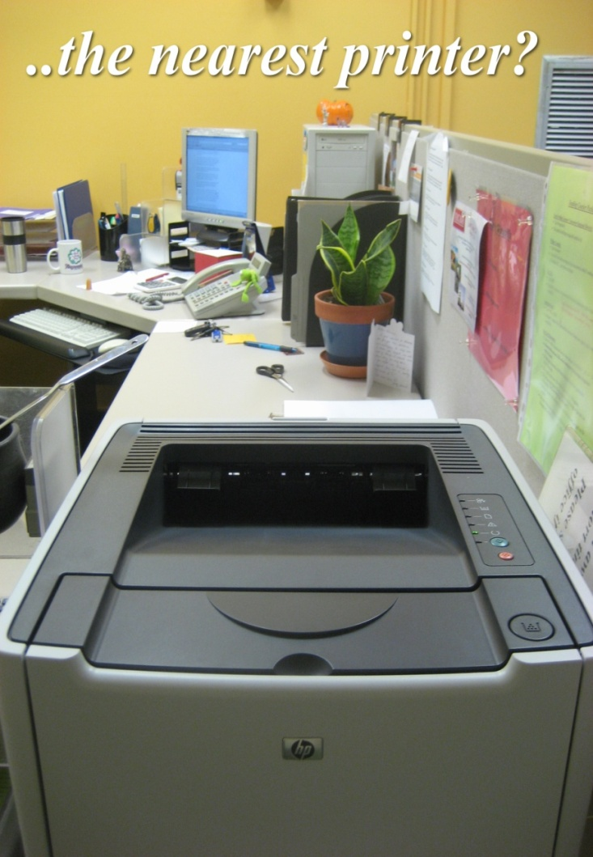

Navigation needs indoors
3. Enterprise services
“Where is ..

Slide 6
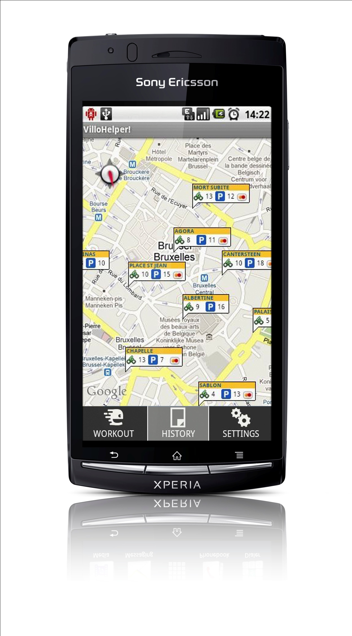


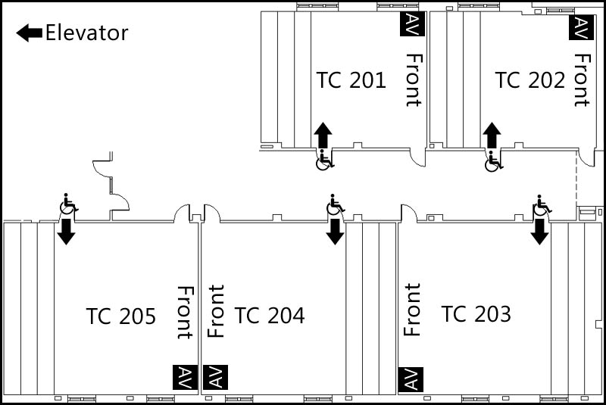

PROPOSED SYSTEM
Comps
VII
Library
Choose your Destination
Library
Comps VII
Comps V
Comps III
Staff-Room
Display a map
Annotate the map
Track the user.
Take a destination as input from user.
Show route
Plot the user activity
Library
Comps
VI

Slide 7

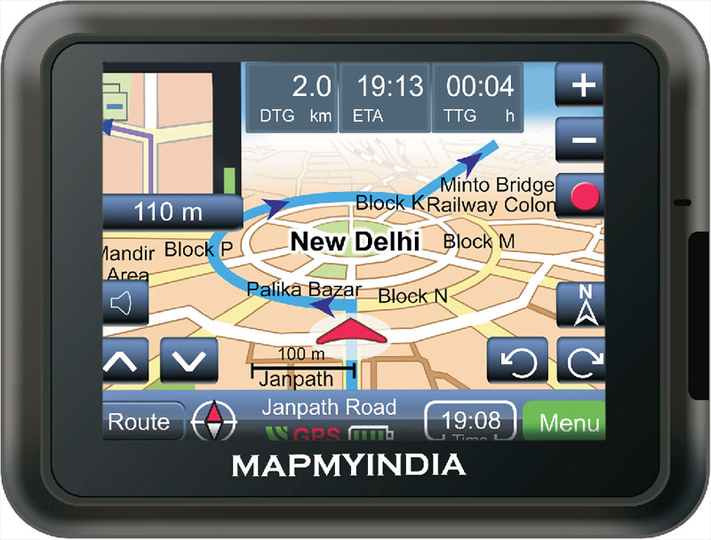
Existing Systems
Google Maps
Positioning Systems
Outdoor
GPS (GNSS maintained by US)
Cellular Communication n/w
Indoor
Wi-Fi
Bluetooth
Infrared

Slide 8
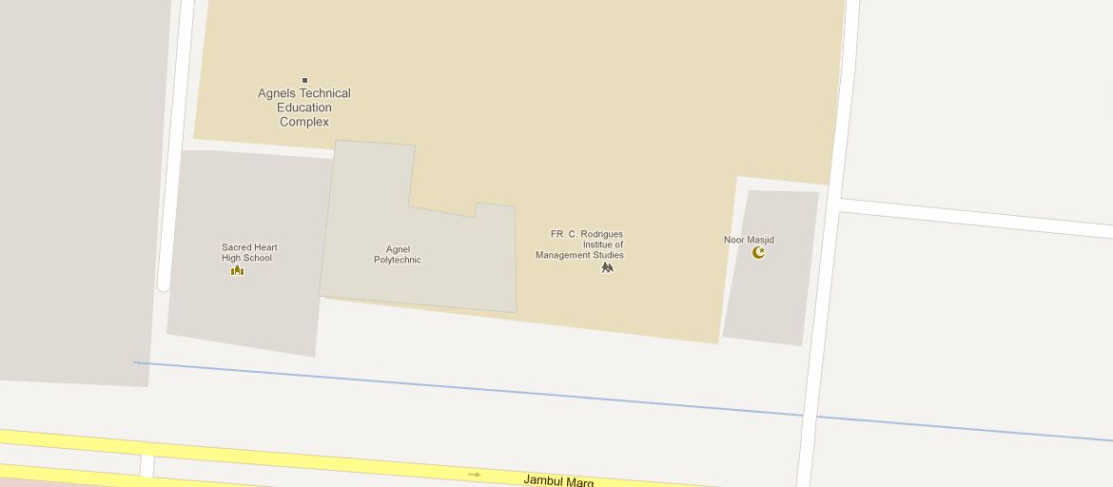

Google maps
I can’t locate the room we are in ...

Slide 9
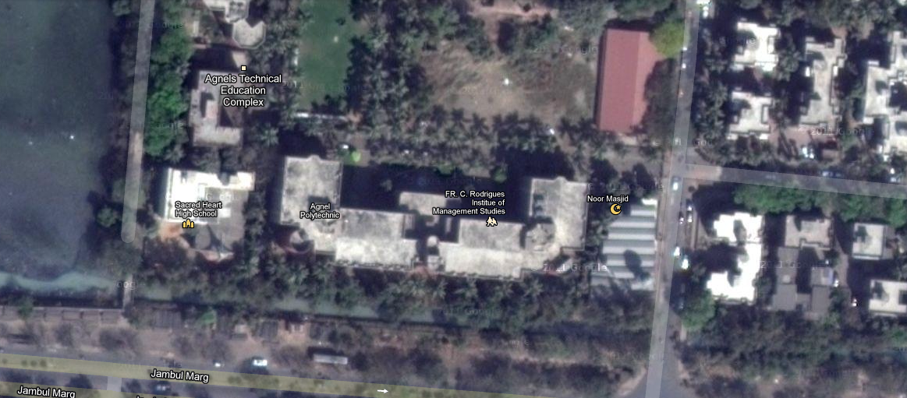
Google maps
Even when I change Google’s options

Slide 10


GPS
GPS can’t locate receivers without Line-Of-Sight

Slide 11





Wi-Fi Triangulation
Wi-Fi Router
Wi-Fi Router
Wi-Fi Router

Slide 12



Solutions in in-MAPS
Mapping
OpenStreetMap is completely open source
Provides comprehensive support for indoor mapping

Slide 13
Solutions in in-MAPS
Positioning
Inertial navigation system (INS) integrating the output of a set of sensors to compute position, velocity, and altitude. The sensors used are compass and accelerometers which are available in ANY Android Smartphone.
Compass: angle with respect to inertial space
Accelerometers measure linear acceleration

Slide 14
Inertial Navigation System
Compass gives orientation
(x_{new}, y_{new})
Measured Acceleration gives displacement
(x_{old}, y_{old})
Real World Space

Slide 15
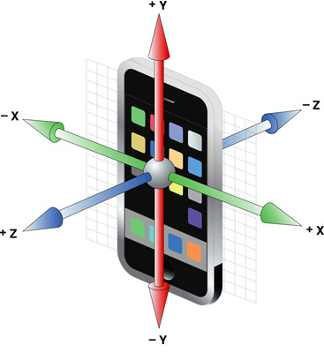
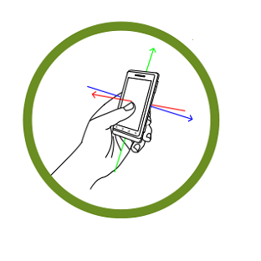
Inertial Navigation System
-ve Z axis of Accelerometer is used
The X axis of Compass is used
The 3 axes of smartphone sensors

Slide 16
SYSTEM ARCHITECTURE
LBS
Smartphone
Smartphone API
Indoor positioning
GPS
Indoor Positioning Enablers
Sensor
OSM Server
XML
Outdoor Maps
Indoor Maps

Slide 17
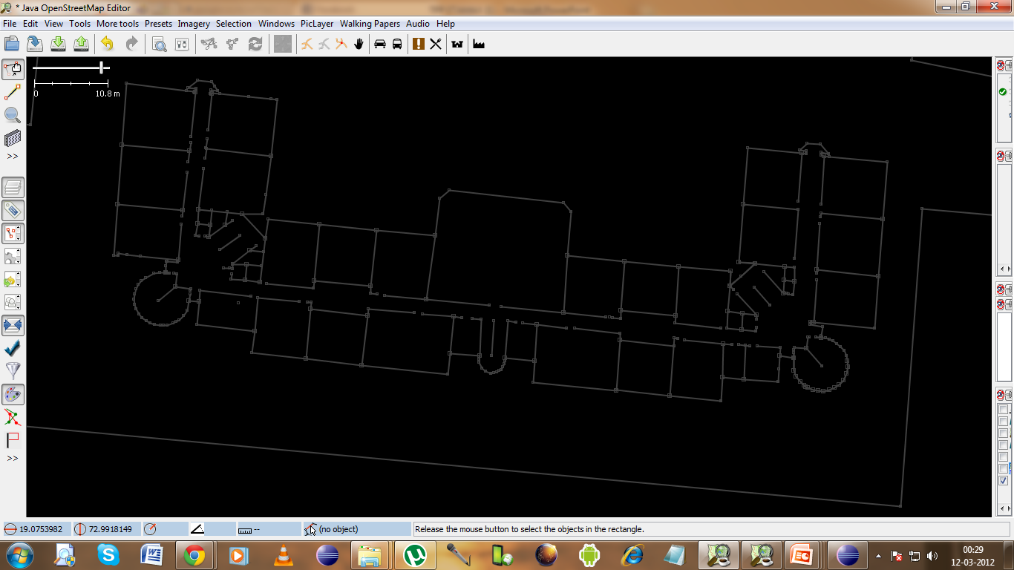
Indoor Map Creation - Outline

Slide 18
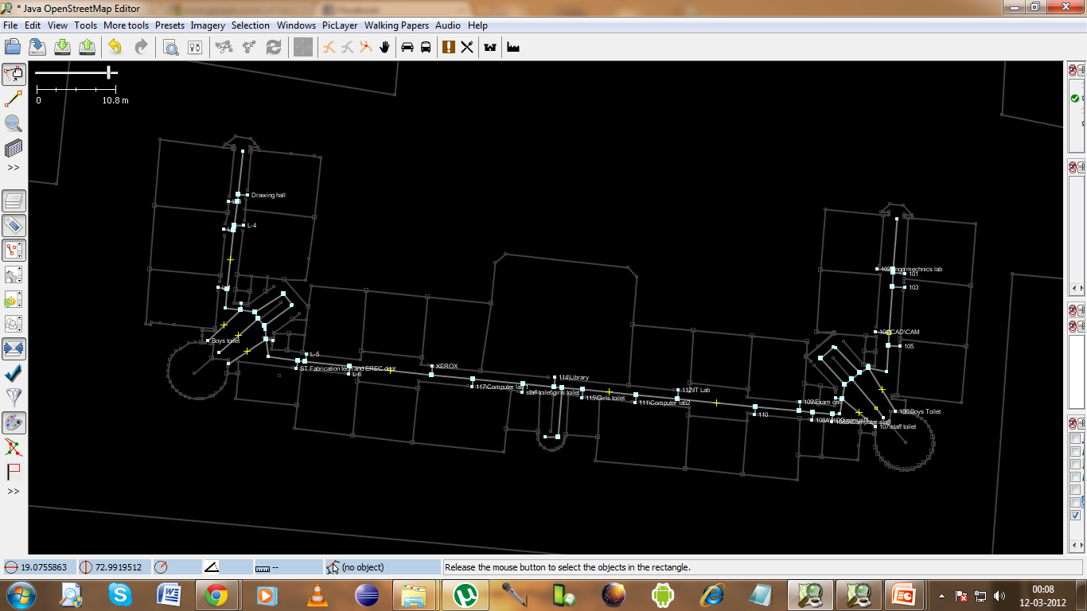
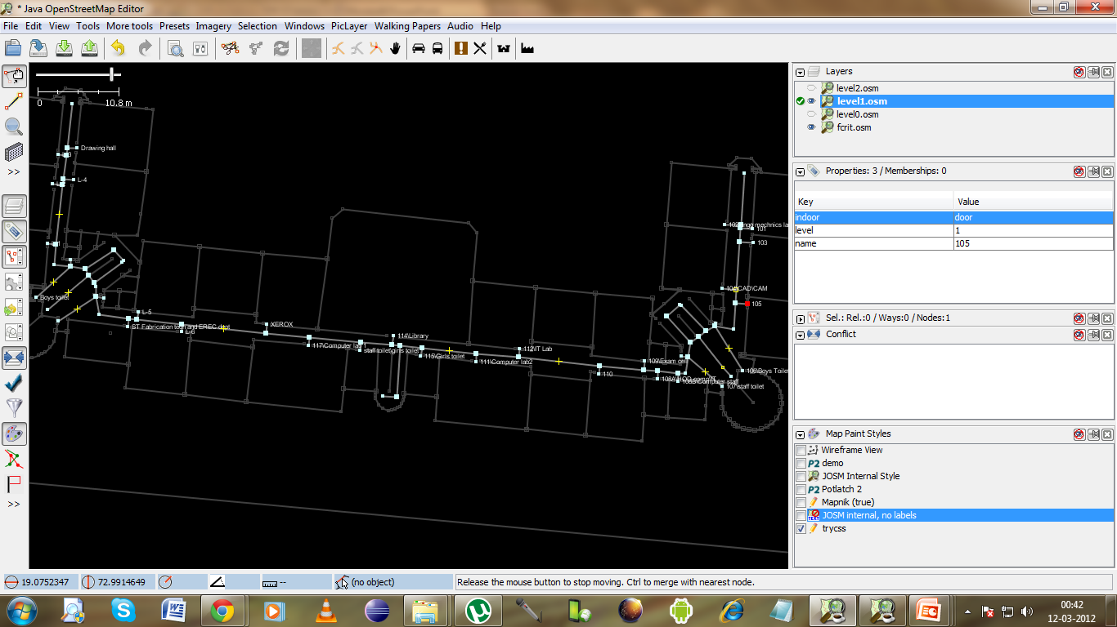
Indoor Map Creation - Routing

Slide 19
OSM Tags
TAG | PURPOSE
indoor=yes | Marks an object as being indoors
level=* | To determine the associated floor of an object.(-1,0,1)
wheelchair=yes | Indicates accessibility by wheelchairs
highway=door | Specifies a node to be a door
building=entrance | Denotes the entry point
merge_id | to merge the ways connecting different floors
name=* | Is used to give an object a common name.

Slide 20

Android Implementation
SensorManager
SensorEvent
XmlResourceParser – will parse .osm files
Activity – will hold the UI
View – extending it to have control over graphical display of map
Bitmap – will hold floor plan images

Slide 21
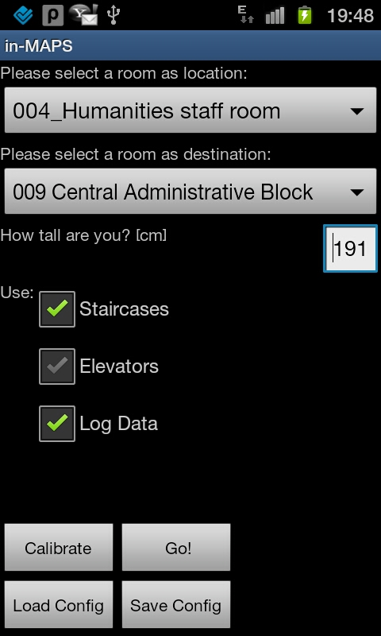
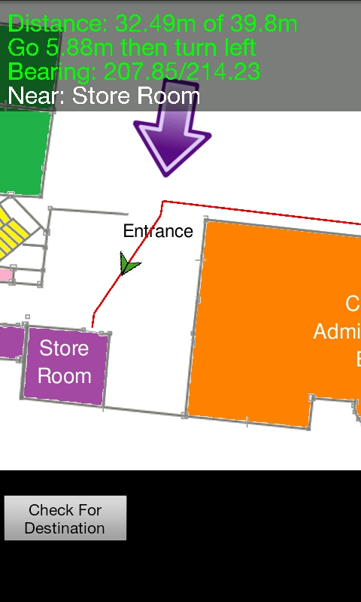
Application Screenshots

Slide 22
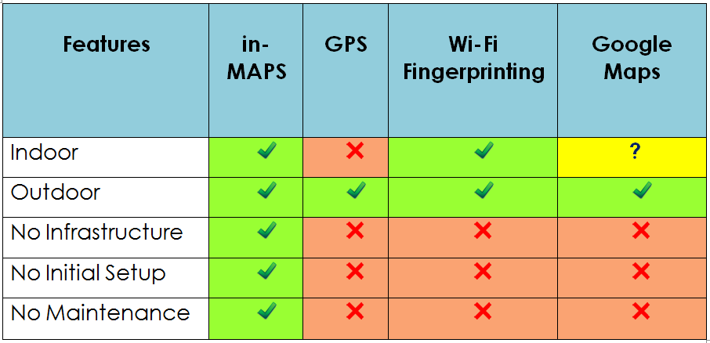
Comparative Analysis

Slide 23
Conclusion
Indoor maps can be created accurately by using floor plans of buildings
Inertial Navigation system is better since it doesn’t need any external infrastructure
Their combination can open up new avenues for applications.

Slide 24
Future Improvements
Navigation for blind
3-D GUI can improve the user experience
More accurate Filtering of input sensor data

Slide 25
References
[1] H Lin, Ying Zhang, M Griss, and I Landa. WASP: an enhanced indoorlocationing algorithm for a congested Wi-Fi environment. Proceedings ofthe Workshop on Mobile Entity Localization and Tracking in GPS-less En-vironnments, pages 183-196, 2009.
[2] Paramvir Bahl and Venkata N. Padmanabhan, "RADAR: an In-building RF-based User Location and Tracking System," in Joint Conference of the IEEE Computer and Communications Societies, vol. 2, 2000, pp. 775-784.
[3] Jeff Thurston, "GALILEO, GLONASS And NAVSTAR A Report on GPS for GIS People," GISCafe.com, 2002.
[4] Kamol Kaemarungsi and Prashant Krishnamurthy, "Modeling of Indoor Positioning Systems Based on Location Fingerprinting," 2004.
[5] Bill R, Cap C, Kofahl M, and Mundt T, "Indoor and Outdoor Positioning in Mobile Environments," Geographical Information Sciences, pp. 91-98, 2004.

Slide 26

Questions, Suggestions,
Doubts

Slide 27
Thank you

